Slide 1
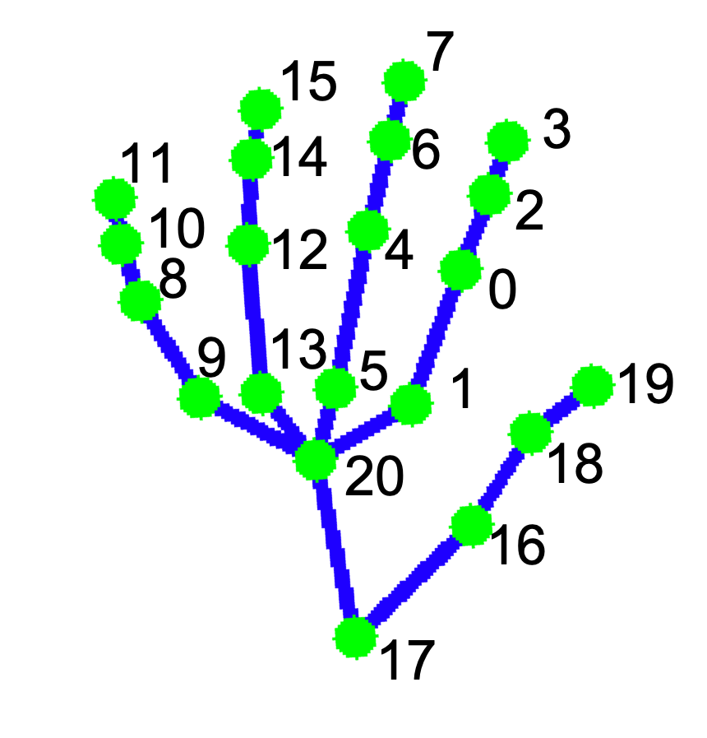
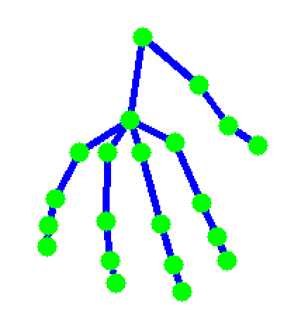
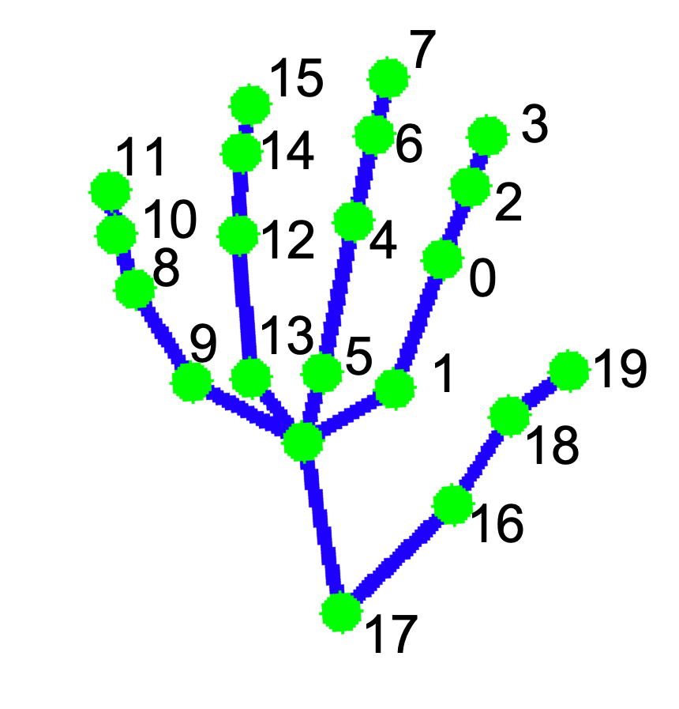
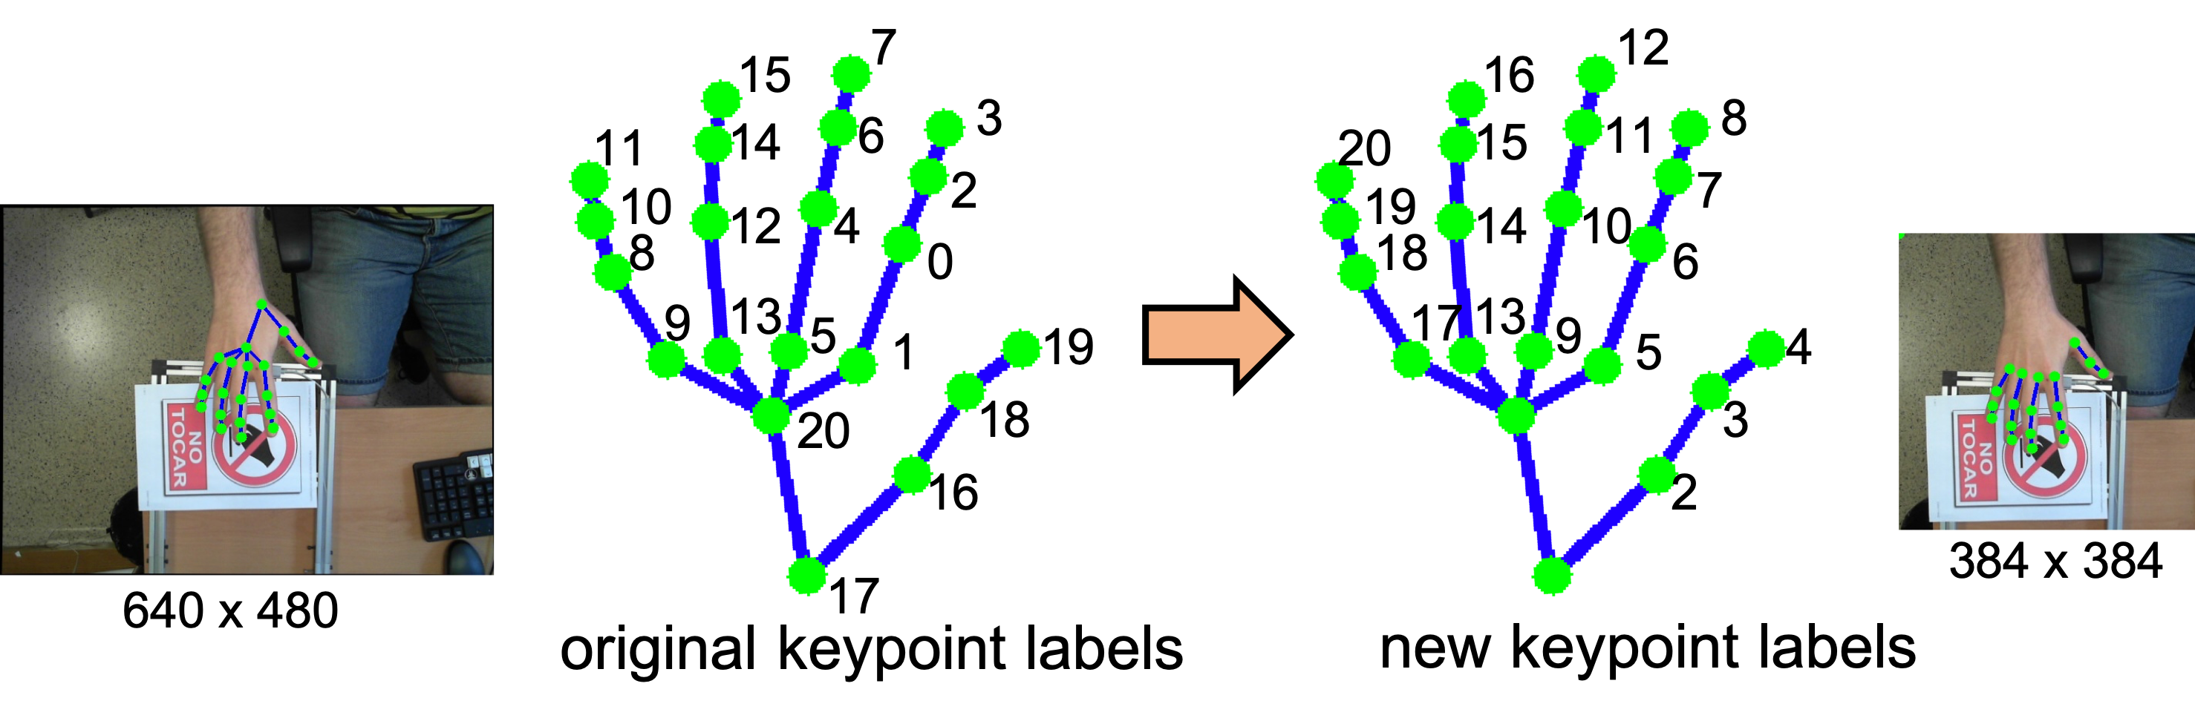
7
15
3
11
14
6
10
2
12
4
8
0
9
13
5
1
19
20
18
16
17

Slide 2
12
16
8
20
15
11
19
7
14
10
18
6
17
13
9
5
4
3
2
OpenPose

Slide 3
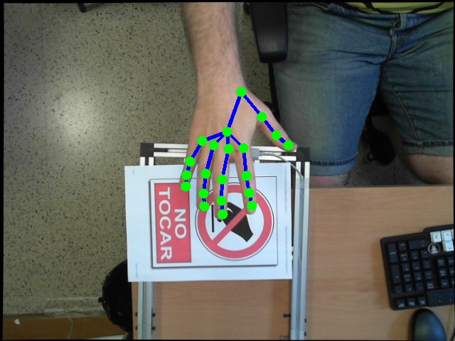
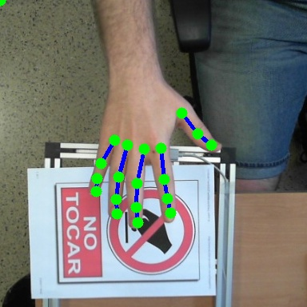
7
12
15
16
3
8
11
14
6
20
15
11
10
2
19
7
12
4
14
10
8
0
18
6
9
13
17
13
5
1
19
9
5
4
20
18
3
16
2
384 x 384
640 x 480
17
original keypoint labels
new keypoint labels

Slide 4
